Slide 1
Making an Art Critic using Machine Learning
Rob Miles
Author and Raconteur
www.robmiles.com

Slide 2
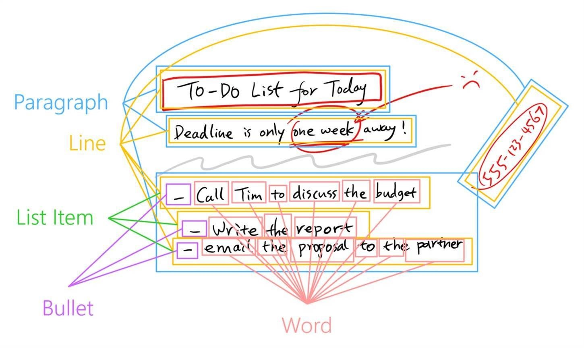
Machine Learning Makes Hard Things Easy
Computers tend to be good at things humans are bad at, and vice versa
Good at chess
Bad at recognising people
Machine Learning (ML) can redress the balance and make the computer good at stuff in a useful way

Slide 3
Machine Learning Makes Hard Things Easy
Computers tend to be good at things humans are bad at, and vice versa
Good at chess
Bad at recognising people
Machine Learning (ML) can redress the balance and make the computer good at stuff in a useful way
Even if we don’t know precisely how it works…..

Slide 4
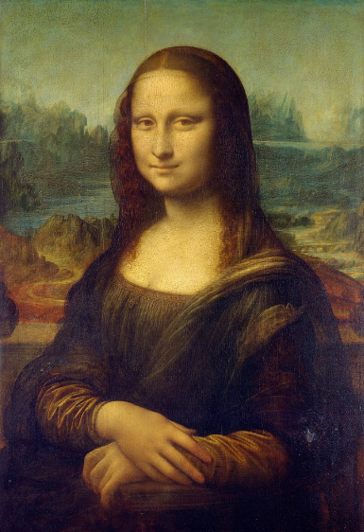
Building an Art Critic
I’m not very good with art
But I know a good picture when I see it
With that in mind, the starting point for a computerised art critic should be something that can recognise different objects
So, lets build one using Machine Learning

Slide 5

Building an Art Critic
I’m not very good with art
But I know a good picture when I see it
With that in mind, the starting point for a computerised art critic should be something that can recognise different objects
So, lets build one using Machine Learning

Slide 6
What we are going to do…
Use training data to build model for image recognition
Incorporate the training data in a Universal Windows Application
Deploy the application and run it on the target device

Slide 7
What we are going to do…
Use training data to build model for image recognition
Use Microsoft Azure to build the model in the cloud
Incorporate the training data in a Universal Windows Application
Deploy the application and run it on the target device

Slide 8
What we are going to do…
Use training data to build model for image recognition
Use Microsoft Azure to build the model in the cloud
Incorporate the training data in a Universal Windows Application
Drop the model into Visual Studio and see how our program can bind to it
Deploy the application and run it on the target device

Slide 9
What we are going to do…
Use training data to build model for image recognition
Use Microsoft Azure to build the model in the cloud
Incorporate the training data in a Universal Windows Application
Drop the model into Visual Studio and see how our program can bind to it
Deploy the application and run it on the target device
Build and run the application

Slide 10
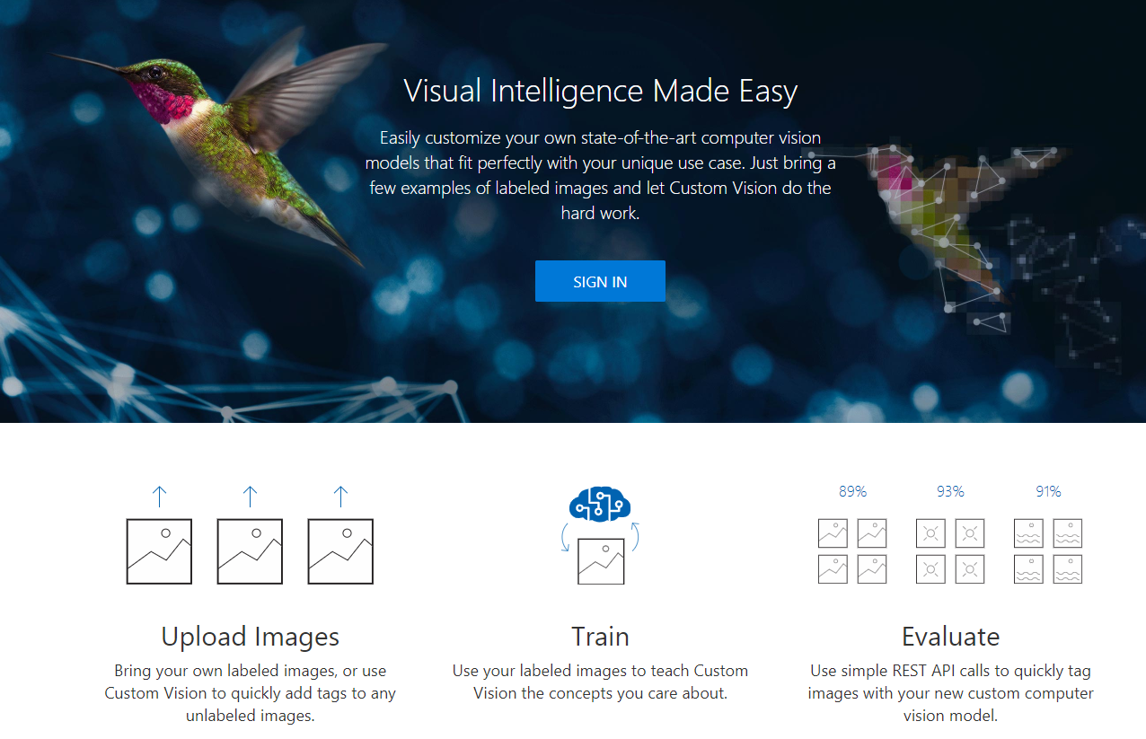
Microsoft Custom Vision
You can create your own models in the cloud using Microsoft Custom Vision
Sign in using your Azure account
Upload images
Build the model
Download it for use in your application
www.customvision.ai

Slide 11
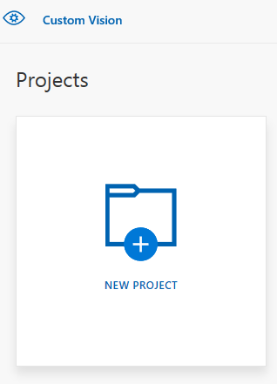
Custom Vision Project
In demo mode you can create two projects with a limited number of figures and classification types
Plenty to get started

Slide 12
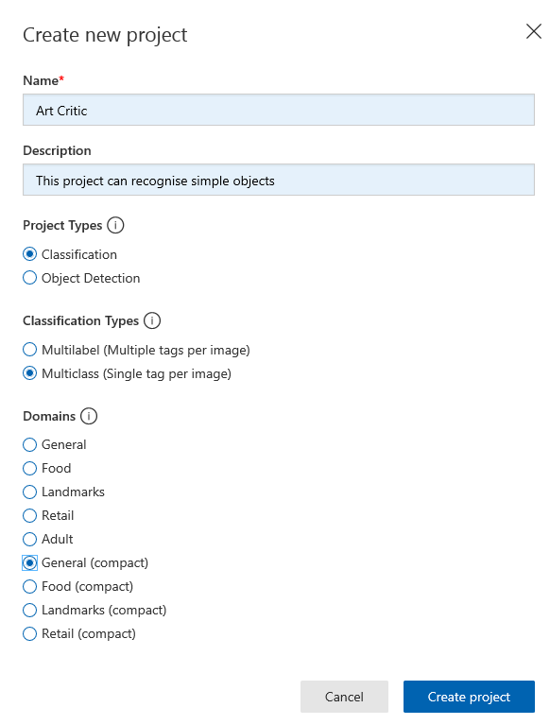
Make a new project
These are the properties of a new project

Slide 13
Make a new project
These are the properties of a new project
Only compact models can be exported

Slide 14
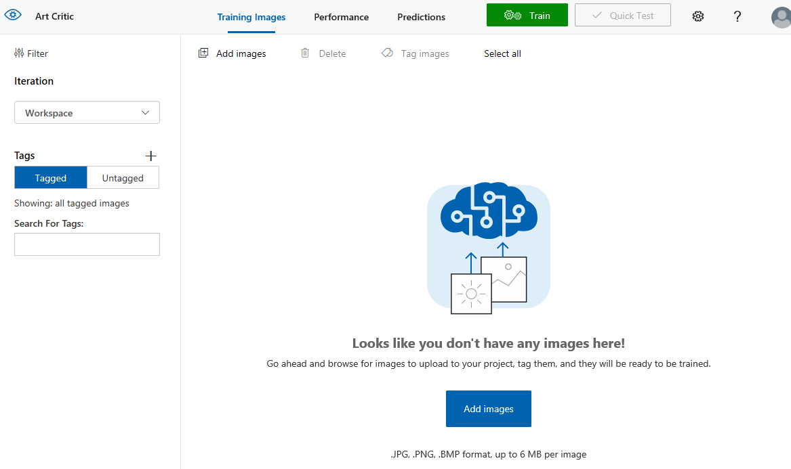
Images
Now that we have our project we can add some images
These can be in formats such as png or jpeg
Note that high resolution might not be your friend
The larger the image, the more data will have to be processed

Slide 15
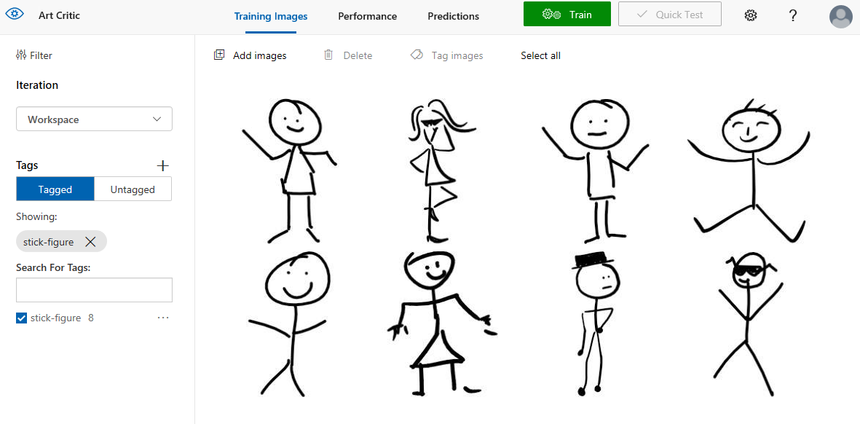
Add some images
Choose your images carefully….

Slide 16
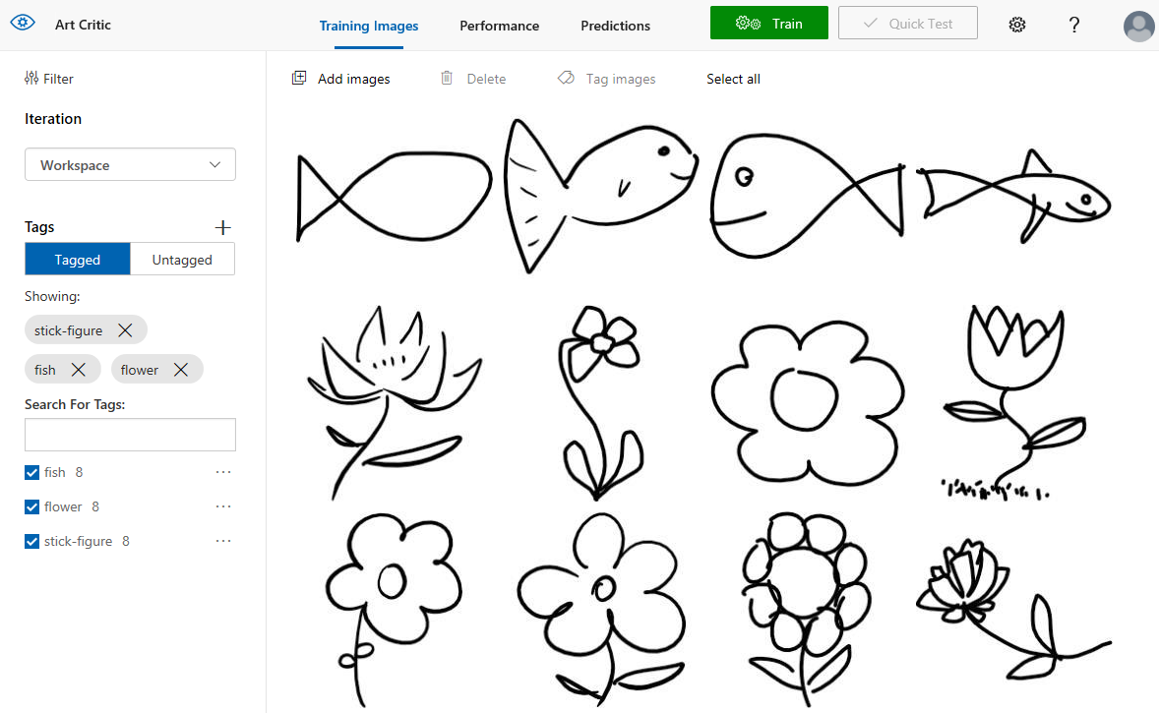
All images loaded
These are all the images loaded
Now we need to use this data to train a model

Slide 17
All images loaded
These are all the images loaded
Now we need to use this data to train a model
Press the Train button to start

Slide 18
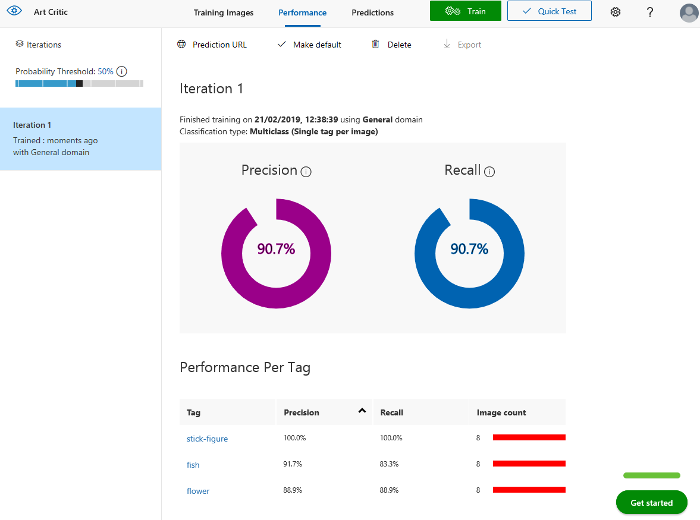
Training results
You get a report of how successful the training was
Precision:
A measure of the likelihood of a tag being predicted correctly
Recall:
Out of the tags that should be predicted correctly, what percentage did the model find
You can use this to tweak your training data
You can also test your model against data with the Quick Test button

Slide 19
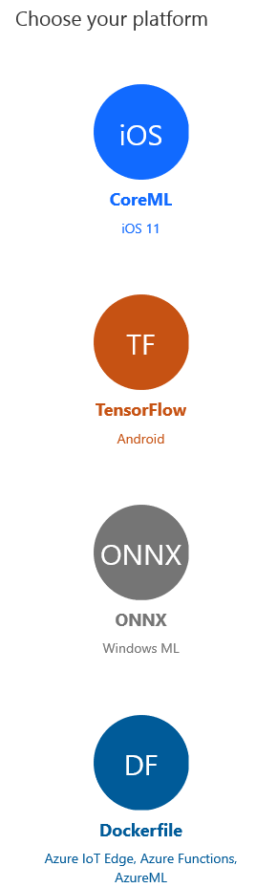
Exporting the model
We now have a model which can be used in applications to allow them to categorise an image based on the training data
We need to export the model to a file that we can incorporate in our application

Slide 20
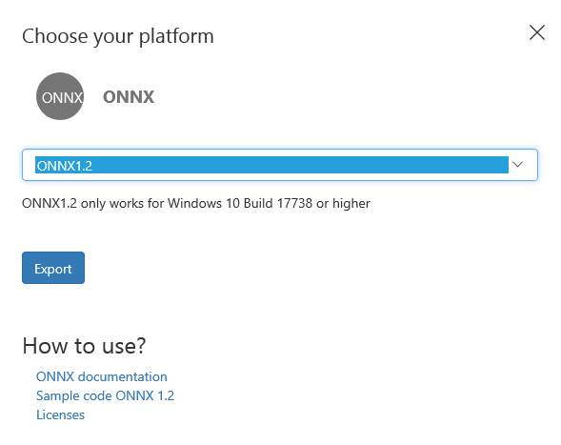
Exporting to ONNX
We are going to use the ONNX format
Version 1.2
Visual Studio can import files of this format

Slide 21

Windows ML uses ONNX models
Notes:
Industry standard format for Machine Learning model interchange
A community project created by Microsoft and Facebook
Defines an extensible computation graph, built-in operators, and standard data types.
Supports a wide range of machine learning models including Classical and Deep Learning algorithms
Learn more at http://onnx.ai/

Slide 22
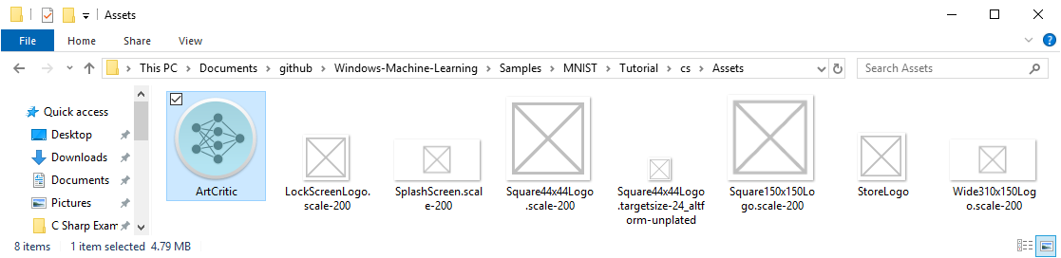
Import the model into Visual Studio
The model can now be imported into Visual Studio
Start by adding it to the Assets file for the application solution

Slide 23
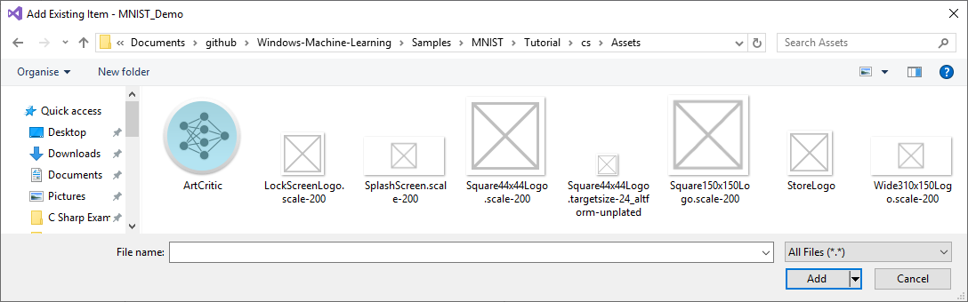
Add the item to the project
Visual Studio will import the model into the solution

Slide 24
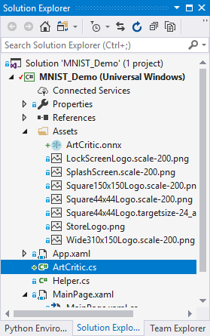
The Model Interface File
When the model is imported into Visual Studio a source file is added to the project that the application can use as an interface to the model
This contains class definitions that describe the model, its input and its outputs

Slide 25
Using the Model
private ArtCriticModel ModelGen;
private ArtCriticInput ModelInput = new ArtCriticInput();
private ArtCriticOutput ModelOutput;
These variables provide the connection between the model and our application
When we want to recognise an object we need to create a ModelInput instance
This happens when the user asks the program to recognise an object
The output from the recognition is supplied in the ModelOutput instance
The program will display this result for the user
Of course your AI program could do anything it likes with the data

Slide 26
Using the Model
private async void recognizeButton_Click(object sender, RoutedEventArgs e)
{
//Bind model input with contents from InkCanvas
VideoFrame vf = await helper.GetHandWrittenImage(inkGrid);
ModelInput.data = ImageFeatureValue.CreateFromVideoFrame(vf);
// Evaluate the model
ModelOutput = await ModelGen.EvaluateAsync(ModelInput);
//Display the results
numberLabel.Text = ModelOutput.classLabel.GetAsVectorView()[0];
}
This is the function that runs when the art critic is asked to “recognise” an image

Slide 27
Using the Model
private async void recognizeButton_Click(object sender, RoutedEventArgs e)
{
//Bind model input with contents from InkCanvas
VideoFrame vf = await helper.GetHandWrittenImage(inkGrid);
ModelInput.data = ImageFeatureValue.CreateFromVideoFrame(vf);
// Evaluate the model
ModelOutput = await ModelGen.EvaluateAsync(ModelInput);
//Display the results
numberLabel.Text = ModelOutput.classLabel.GetAsVectorView()[0];
}
This code gets the image that the user has drawn
This turns out to be quite easy

Slide 28
Using the Model
private async void recognizeButton_Click(object sender, RoutedEventArgs e)
{
//Bind model input with contents from InkCanvas
VideoFrame vf = await helper.GetHandWrittenImage(inkGrid);
ModelInput.data = ImageFeatureValue.CreateFromVideoFrame(vf);
// Evaluate the model
ModelOutput = await ModelGen.EvaluateAsync(ModelInput);
//Display the results
numberLabel.Text = ModelOutput.classLabel.GetAsVectorView()[0];
}
The ImageFeatureValue class is the way that a program passes images into an ML application
This code creates an instance of ImageFeatureValue from the captured video and then sets the data property of the model input to this object

Slide 29
Using the Model
private async void recognizeButton_Click(object sender, RoutedEventArgs e)
{
//Bind model input with contents from InkCanvas
VideoFrame vf = await helper.GetHandWrittenImage(inkGrid);
ModelInput.data = ImageFeatureValue.CreateFromVideoFrame(vf);
// Evaluate the model
ModelOutput = await ModelGen.EvaluateAsync(ModelInput);
//Display the results
numberLabel.Text = ModelOutput.classLabel.GetAsVectorView()[0];
}
This method call is where the Model is used to analyse the input
Note that this call is performed asynchronously
It delivers an instance of the result

Slide 30
Using the Model
private async void recognizeButton_Click(object sender, RoutedEventArgs e)
{
//Bind model input with contents from InkCanvas
VideoFrame vf = await helper.GetHandWrittenImage(inkGrid);
ModelInput.data = ImageFeatureValue.CreateFromVideoFrame(vf);
// Evaluate the model
ModelOutput = await ModelGen.EvaluateAsync(ModelInput);
//Display the results
numberLabel.Text = ModelOutput.classLabel.GetAsVectorView()[0];
}
The output for this model is in the form of a TensorString
a TensorString is how the Machine Learning framework represents collections of strings
We just have to pull out one string from this, which is the name of the category recognised category

Slide 31
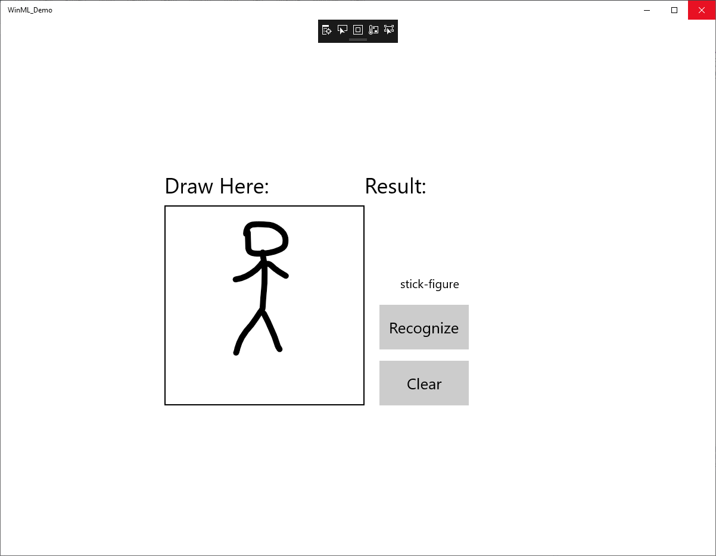
DEMO
Running the Art Critic

Slide 32
Summary
It is very easy to create models and use them
The model is created in the cloud but used in the device
This is “edge” ai – no need for even a network connection
The device can even be a Raspberry Pi
The ai model can run on a GPU if one is available
Visual Studio can import and use ONNX models directly and will make the wrapper classes for you
What you do with the model is entirely up to you
You can download the code and this presentation from:
https://github.com/CrazyRobMiles/MLArt-Critic
www.robmiles.com

